Slide 1
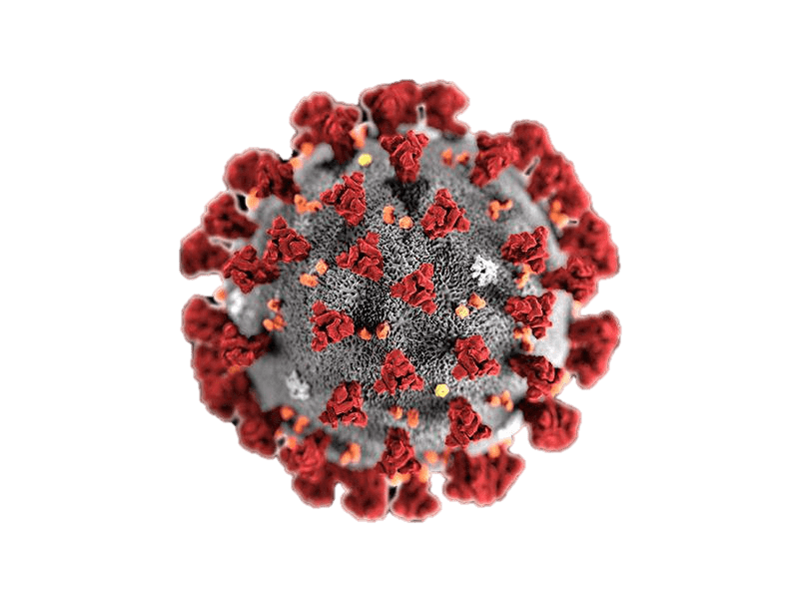


CORONA VIRUS ANALYSIS USING SQL
BY: MANAV SHAH

Slide 2
COVID-19
COVID-19 is an infectious disease caused by the found virus known as SARS-CoV-2 (or coronavirus). Before the originated in Wuhan, China on December 2019, there was no information about this virus

Slide 3
Project overview
Corona Virus Analysis
The CORONA VIRUS pandemic has had a significant impact on public health and has created an urgent need for data-driven insights to understand the spread of the virus. As a data analyst, you have been tasked with analyzing a CORONA VIRUS dataset to derive meaningful insights and present your findings.

Slide 4
Dataset :-
Province: Geographic subdivision within a country/region.
Country/Region: Geographic entity where data is recorded.
Latitude: North-south position on Earth's surface.
Longitude: East-west position on Earth's surface.
Date: Recorded date of CORONA VIRUS data.
Confirmed: Number of diagnosed CORONA VIRUS cases.
Deaths: Number of CORONA VIRUS related deaths.
Recovered: Number of recovered CORONA VIRUS cases.

Slide 5
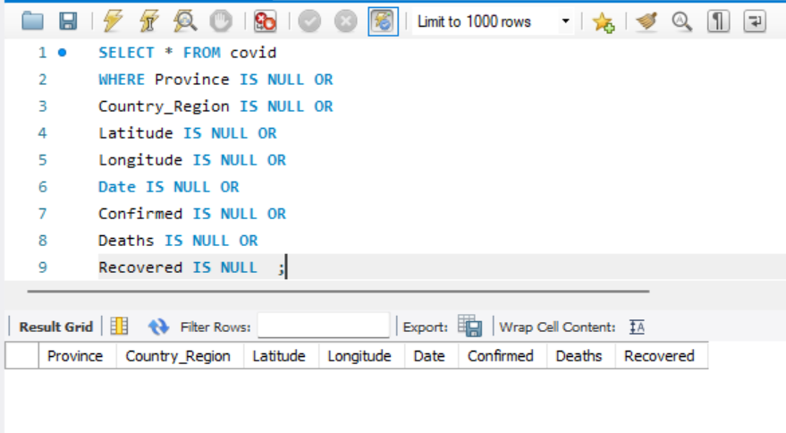
Q1. Write a code to check NULL values

Slide 6
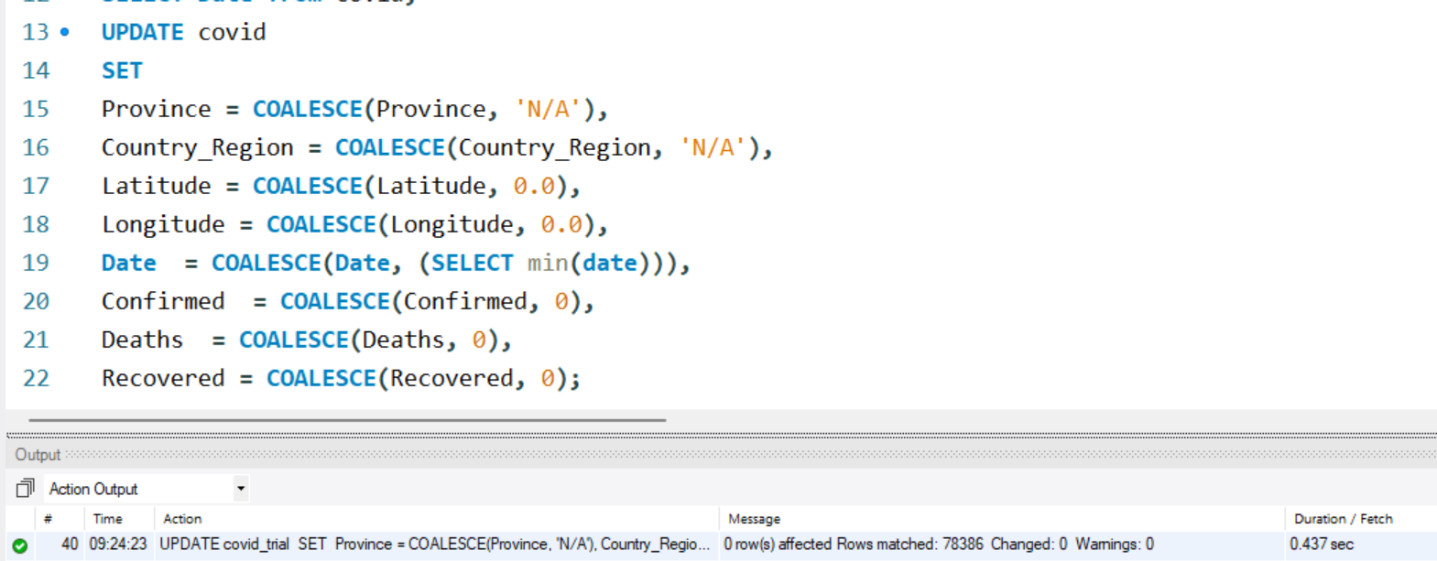
Q2. If NULL values are present, update them
with zeros for all columns.

Slide 7
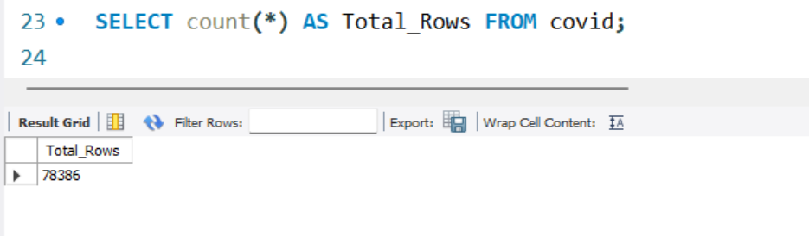
Q3. check total number of row.

Slide 8
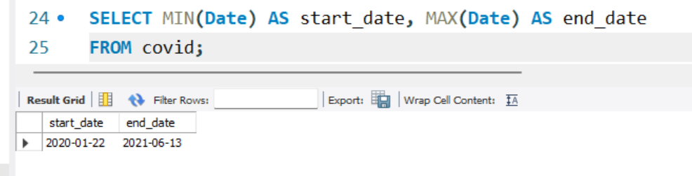
Q4. Check what is start_date and end_date

Slide 9
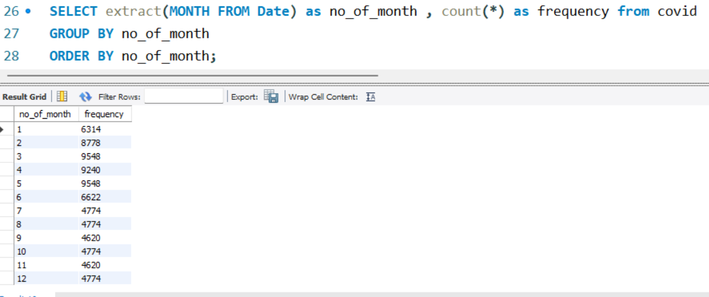
Q5. Number of month present in dataset

Slide 10
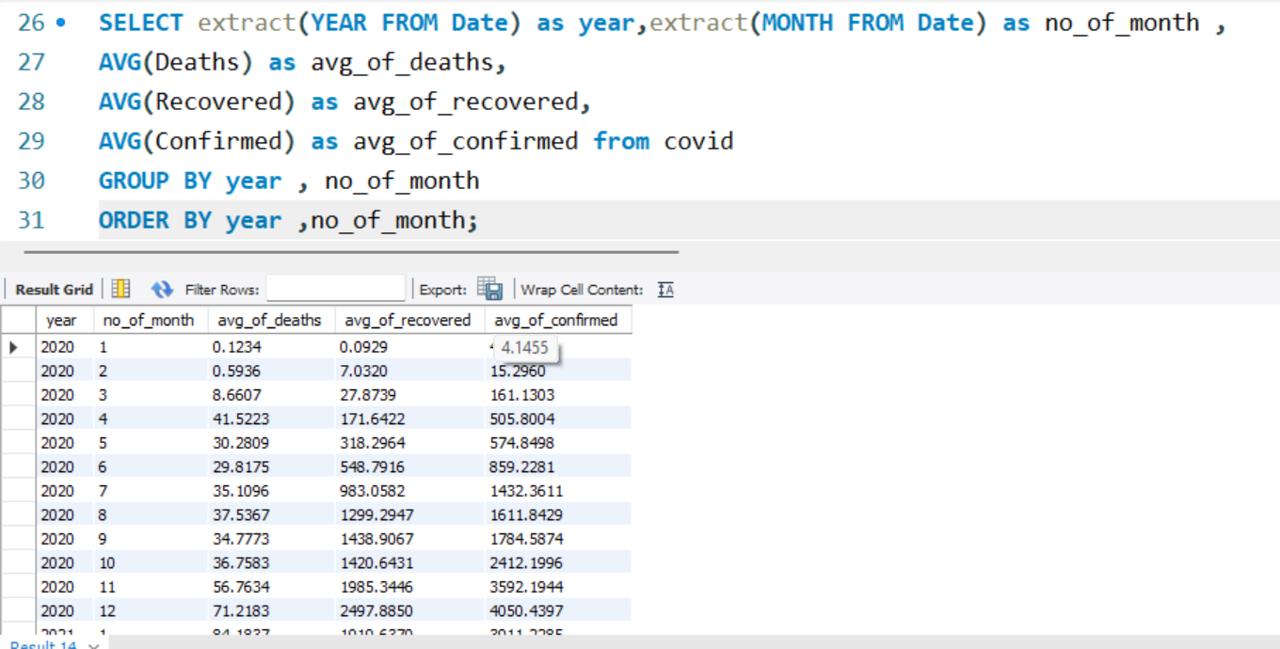
Q6. Find monthly average for confirmed,
deaths, recovered

Slide 11
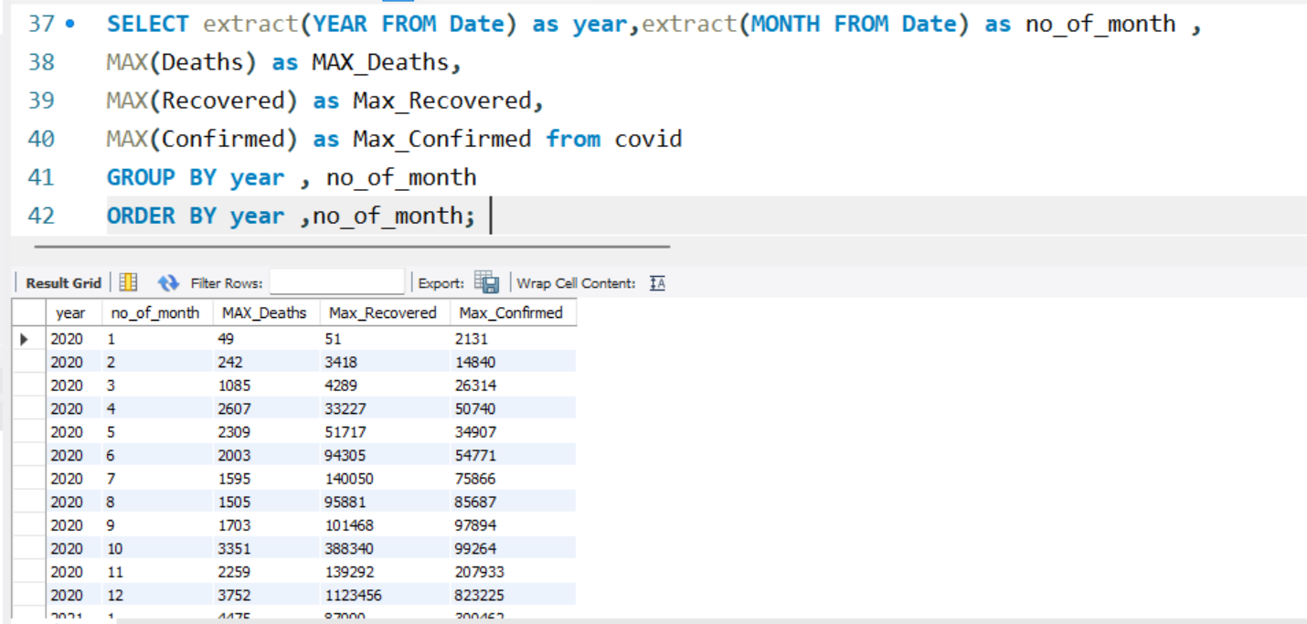
Q7. Find most frequent value for confirmed, deaths, recovered each month

Slide 12
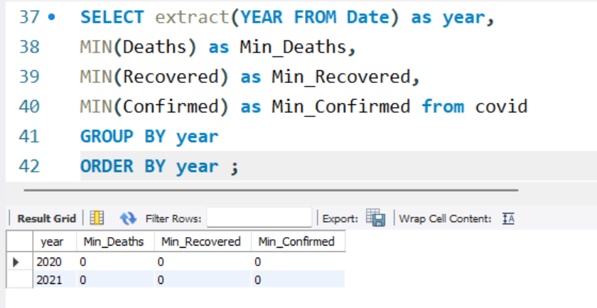
Q8. Find minimum values for confirmed,
deaths, recovered per year

Slide 13
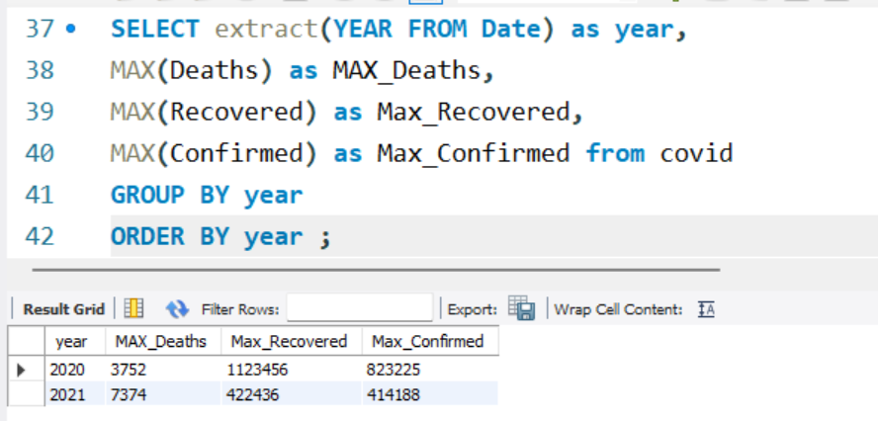
Q9. Find maximum values of confirmed,
deaths, recovered per year

Slide 14
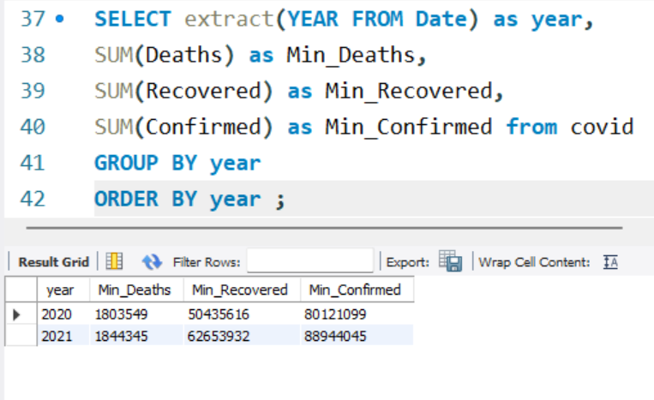
Q10. The total number of case of confirmed, deaths, recovered each month

Slide 15
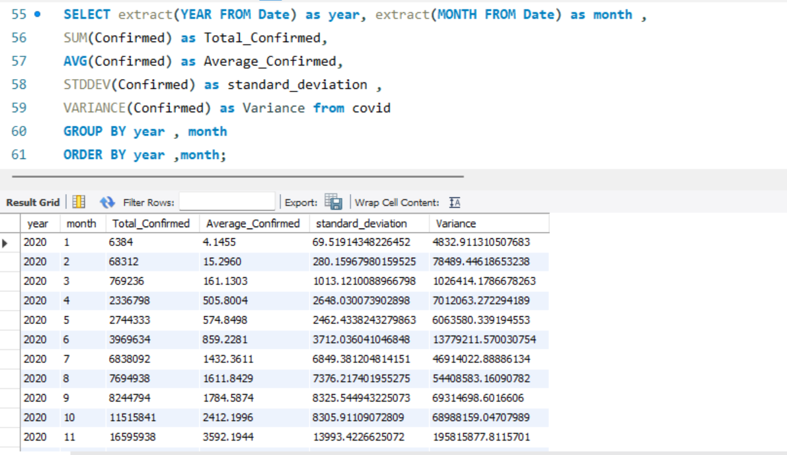
Q11. Check how corona virus spread out with respect to confirmed case

Slide 16
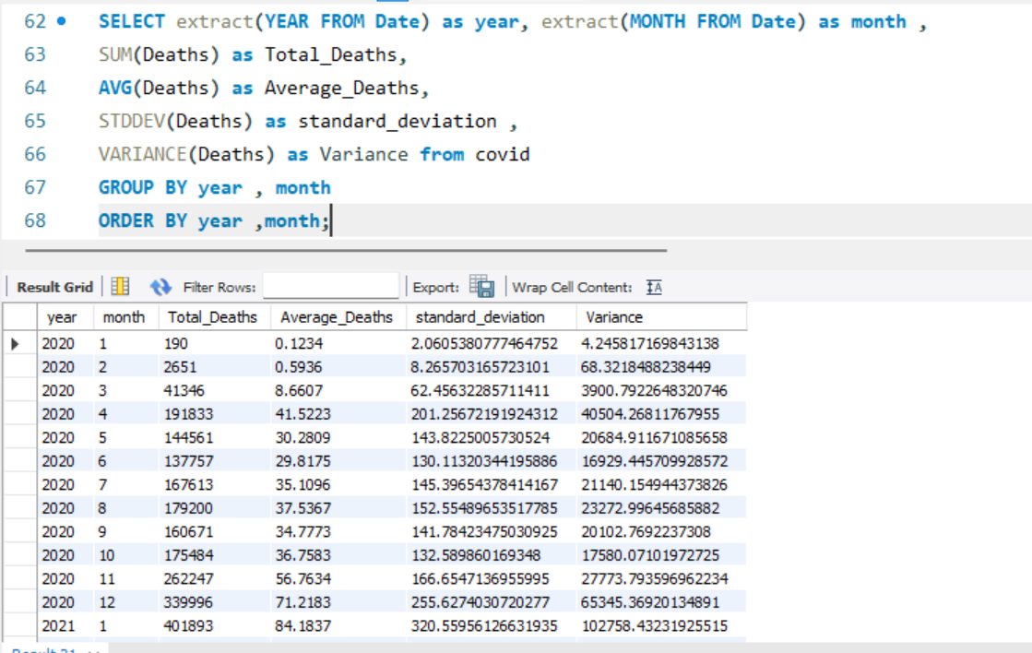
Q12. Check how corona virus spread out with respect to death case per month

Slide 17
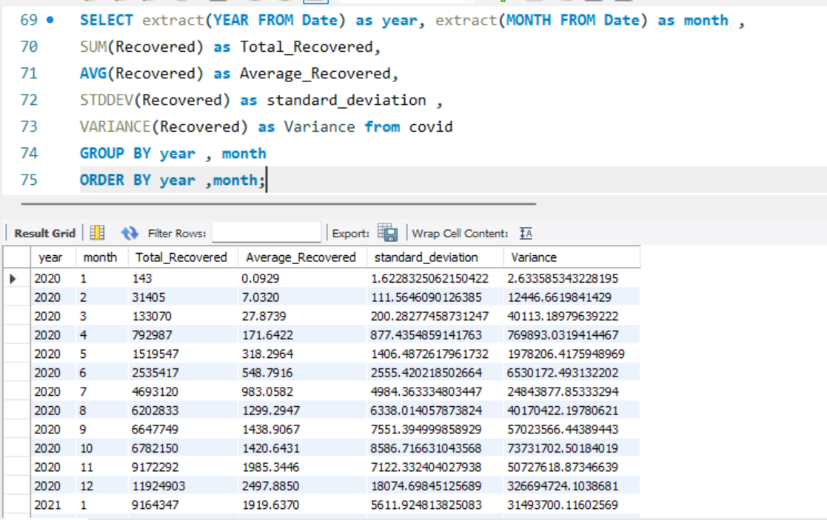
Q13. Check how corona virus spread out with respect to recovered case

Slide 18
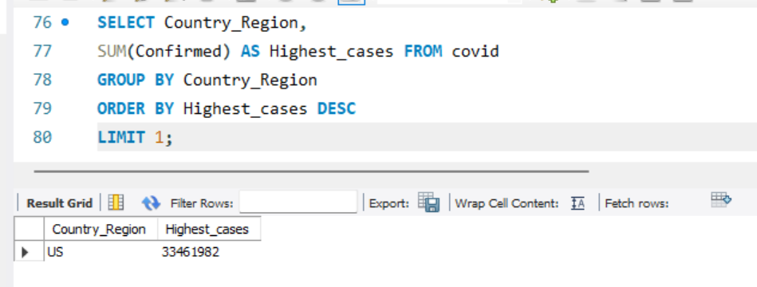
Q14. Find Country having highest number
of the Confirmed case

Slide 19
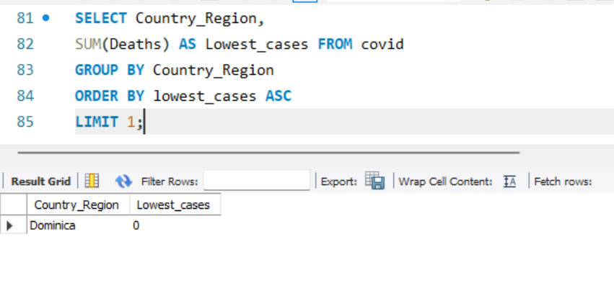
Q15. Find Country having lowest number
of the death case

Slide 20
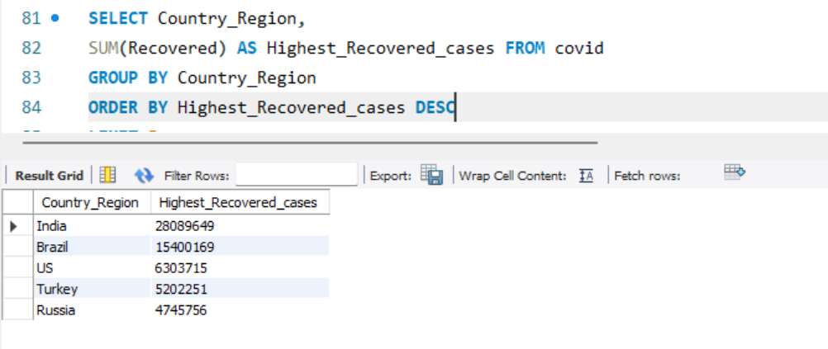
Find top 5 countries having highest
recovered case

Slide 21
Insights

Slide 22
5 Countries With The Highest
Number Of Cases
Country | Confirmed cases
US | 33461982
India | 29460523
Brazil | 17412766
France | 6106009
Turkey | 5330447

Slide 23
5 Countries With The Highest
Number Of recovered
Country | Recovered cases
India | 28089649
Brazil | 15400169
US | 6303715
Turkey | 5202251
Russia | 4745756

Slide 24
5 Countries With The Highest
Number Of Deaths
Country | Deaths
US | 599769
Brazil | 487401
India | 370730
Mexico | 230150
Peru | 188708

Slide 25
Total Reported cases of COVID-19
16,90,65,144
Total Recovered cases of COVID-19
11,30,89,548
Total deaths due to COVID-19
36,47,894

Slide 26



Thank You!
By – manavshah1704@gmail.com

